Slide 1


SAP UI5 & FIORI with OData TRAINING using BAS
Sakshi Gupta
Day – 14

Slide 2

Agenda – Day 14
Fiori Extension Pack in VS Code
Fiori Elements – List Report Application
Object Page
Analytic List page
Visual Filters
Annotations of an Analytic Card

Slide 3

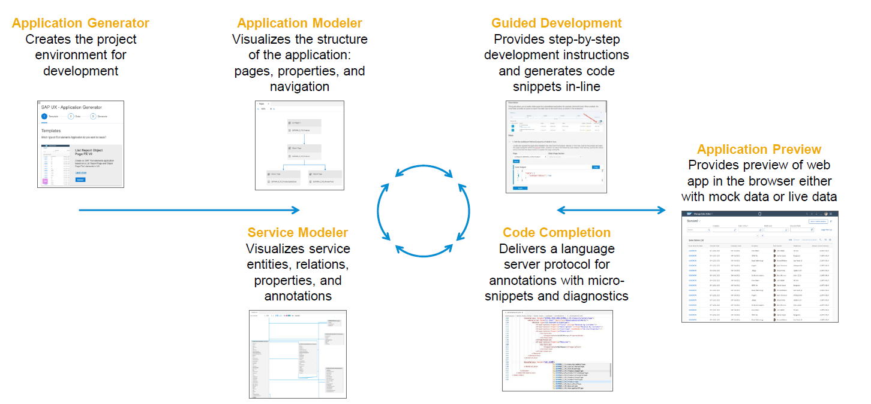
Fiori Extension Pack in VS Code
www.anubhavtrainings.com

Slide 4
Fiori Elements - List Report Application
The list report offers powerful features for finding and acting on relevant data sets. It is often used as an entry point for navigating to the item details, which are usually shown on an object page.
List Report
Object Page

Slide 5
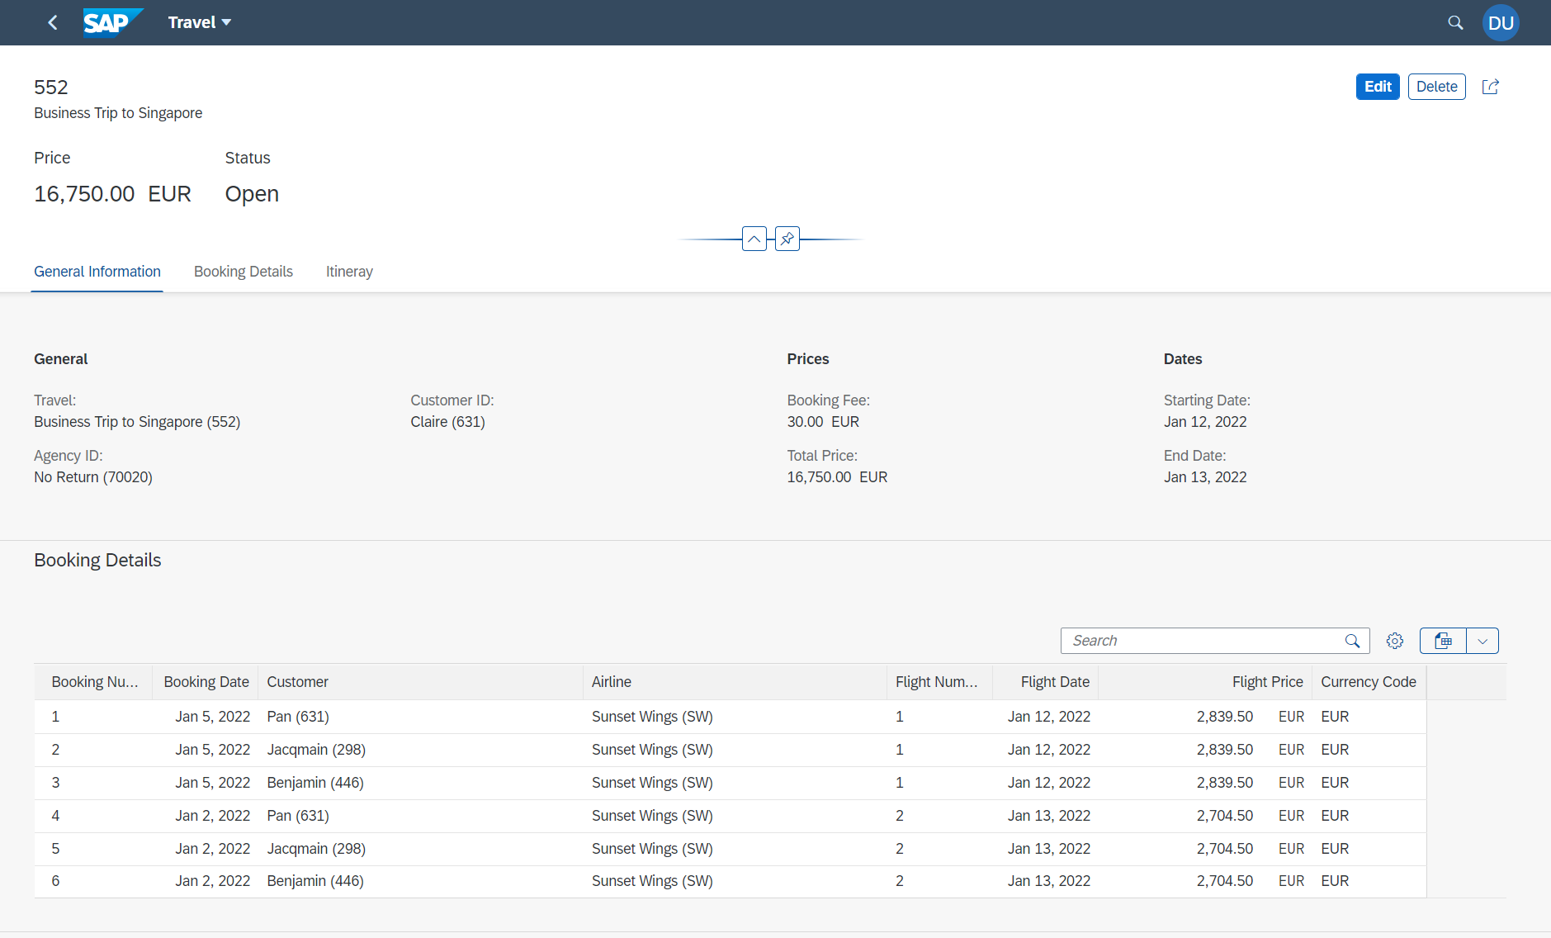
Components of an Object Page
www.anubhavtrainings.com

Slide 6
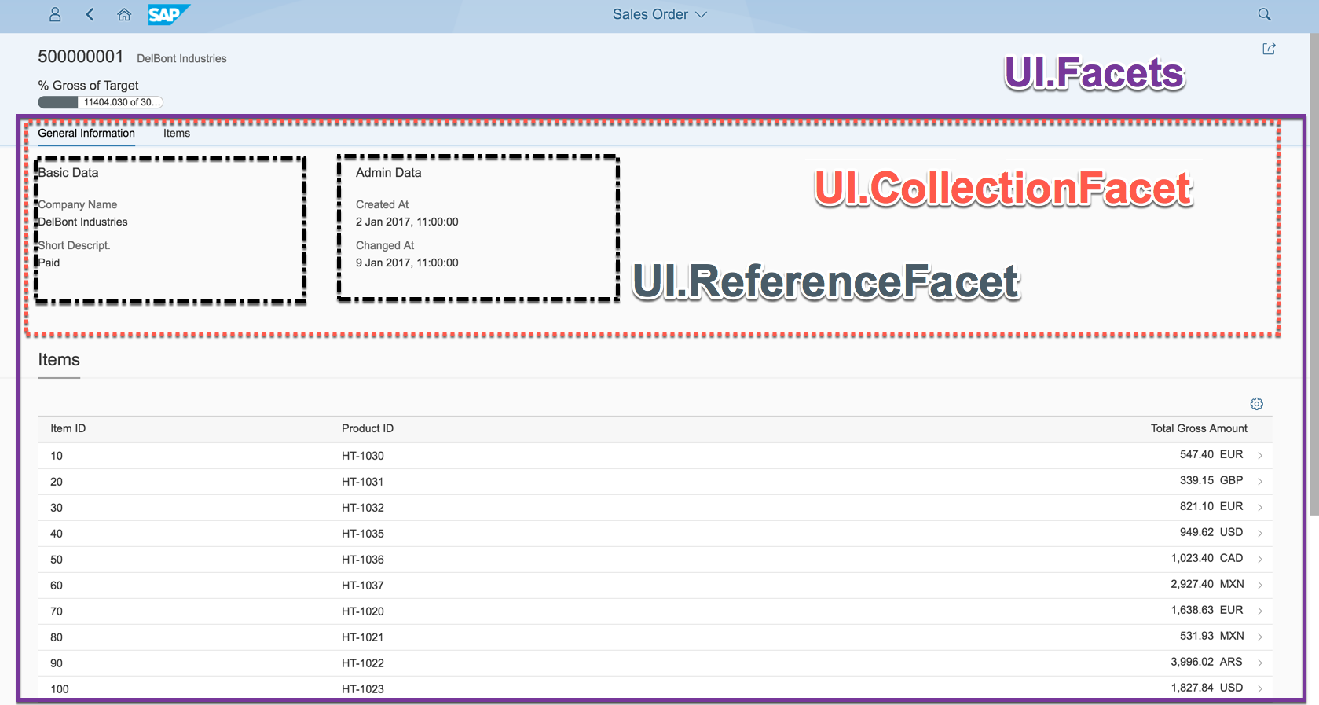
Object Page
www.anubhavtrainings.com

Slide 7
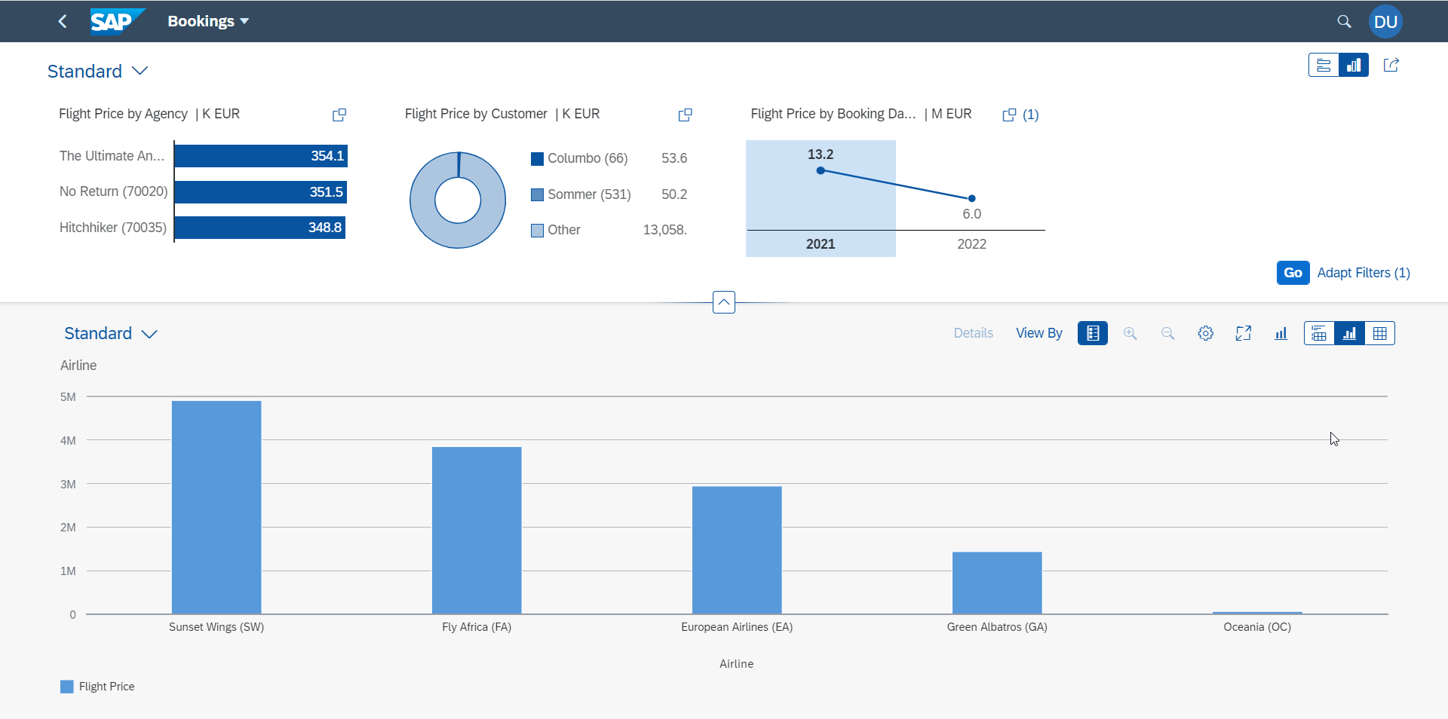
Analytic List Page
A ALP is used to display analytics as well as line item data in list. We can analyze data distribution across multiple dimensions for our measures. It also allows along with filter bar a special types of filter called visual filter.
www.anubhavtrainings.com

Slide 8
3 Steps to add Visual Filters
Step 1: Create a Chart by specifying the Dimension and Measures
Step 2: Create Presentation variant to display the chart and set its initial settings
Step 3: For the field (e.g. Agency) add a Value List which includes a Collection Type pointing to our Presentation Variant, Additionally we will specify the filter criteria.
www.anubhavtrainings.com

Slide 9
Question
Suppose in Fiori Elements when we create a Travel Request, we add multiple bookings.
I want to default the Customer ID because it was already selected on previous screen.
In SAP ABAP RAP we have a concept of Determination.
www.anubhavtrainings.com

Slide 10
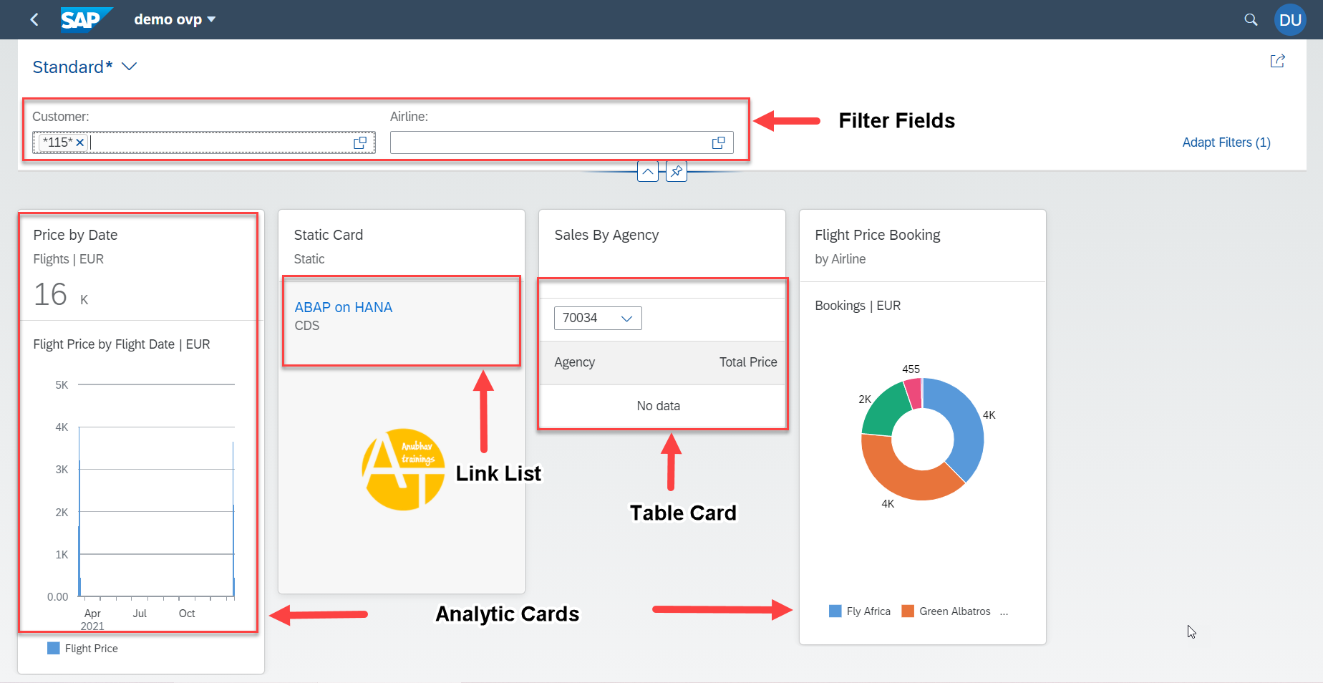
Overview Page
www.anubhavtrainings.com

Slide 11
Annotations of an Analytic Card
@UI.Chart Annotations
- Dimension Attributes – About X Axis and Category
- Measure Attributes – About Y Axis and AXIS#1 (Container numeric values)
@UI.DataPoint – It will be used to show total value as KPI on top of card.
@UI.PresentationVariant – Control how the chart will presented to user when app start. Options are like Filter, MaxItem, Sorting, Grouping.
@UI.Identification – Used for navigation
Finally using annotations we will define a analytic card on manifest.json
Table Card
@UI.DataPoint = used to define a number with criticality calculation for a numeric column inside table
@UI.lineItem = Define the columns which we want to display
@UI.SelectionVariant = Apply Filter on data
@UI.Identification = Cross App navigation
Finally we will add a Table card showing all the data.
www.anubhavtrainings.com

Slide 12

End of Day 14

Slide 13

Questions

Slide 14

Shekhar Vedi

Slide 15


We’re committed to empower you to be
Most Desirable Resource
through powerful training solutions.
We build the workforce of the future.
250+
Corporate Clients
30,000+
Learners Trained
25000+
Learners Placed
FREE WEBINARS
Sign up for free webinars with industry experts every fortnight!
Enroll Now!
Contact us today!
https://anubhavtrainings.com/

Slide 16




More from AnubhavTrainings.com

Slide 17
Title
Content

